Slide 1
1: Introduction
Mobile App Development

Slide 2
Mobile Device
A mobile device is a portable electronic equipment that can connect to the internet, especially a smartphone or tablet computer.
These devices are designed to be extremely portable, and they can often fit in your hand.
Today’s mobile devices are multifunctional devices capable of hosting a broad range of applications for both business and consumer use.
Some mobile devices—like tablets, e-readers, and smartphones—are powerful enough to do many of the same things you can do with a desktop or laptop computer.

Slide 3
Mobile Device
Uses of Mobile Devices:
Communication
Small and Convenient
Photos and Video
Texting
Fashion and Self-Expression
Entertainment
Notes and Reminders
Video in Real Time
Calendars and Organization
Maps, Navigation, and Travel
Online Banking and Finance
Address Book and Contacts

Slide 4
Mobile Ecosystem
Mobile Ecosystem is collection of multiple:
Devices (mobile phones, Tablet, Phablet etc),
Software (operating system, development tools, testing tools etc.),
Companies (device manufacturers, carrier, apps stores, development/testing companies, etc.)
Processes through which data is shared by users from one device to another or to itself(sms etc)
Data(Text, Voice, Multimedia) sharing can be done between devices having same operating system or different operating system.

Slide 5
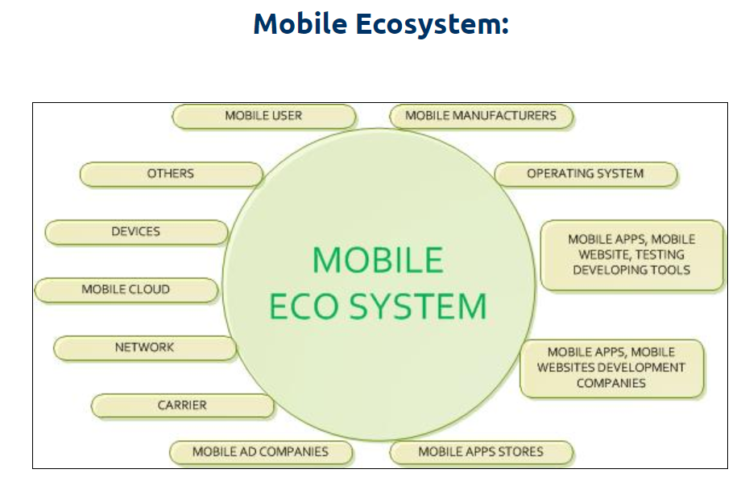

Slide 6
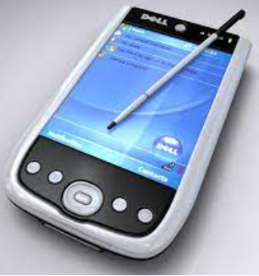
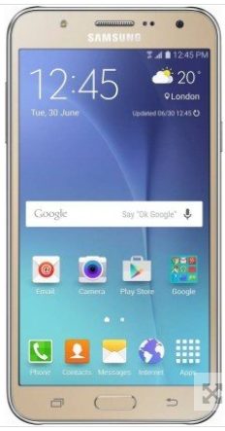
Mobile device categories
Types / Categories:
Personal Digital Assistant (PDA)
Sometimes called pocket computers, PDAs are handheld devices that combine elements of computing, telephone/fax, Internet and networking in a single device. A typical PDA can function as a cellular phone, fax sender, Web browser and personal organizer.
Smartphones
Smartphones combine a mobile phone and a handheld computer into a single device. Smartphones allow users to access and store information (e.g. e-mail) and install programs (applications) while also being able to use a mobile phone in one device. Examples of smartphones: Apple iPhone, Samsung Galaxy, Microsoft and Nokia Lumia.

Slide 7
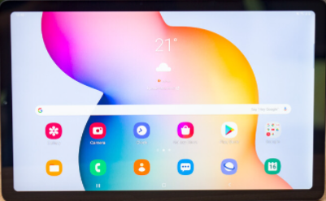
Mobile device categories
Types / Categories:
Tablet PCs
A tablet computer, commonly shortened to tablet, is a mobile device, typically with a mobile operating system and touchscreen display processing circuitry, and a rechargeable battery in a single, thin and flat package.
Tablets can be used to browse the Internet, check email, download and read books, play games, watch videos, organize content, and much more. Most tablets are touch operated and are between the size of a smartphone and a laptop.

Slide 8
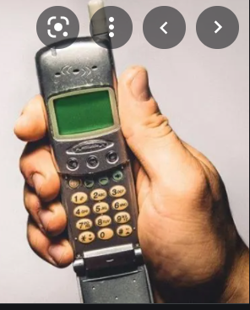
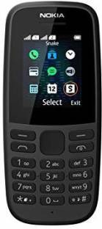
Types / Categories:
Mobile Phone: A mobile phone is a wireless handheld device that allows users to make and receive calls.
While the earliest generation of mobile phones could only make and receive calls, today’s mobile phones do a lot more, accommodating web browsers, games, cameras, video players and navigational systems.
Also, while mobile phones used to be mainly known as “cell phones” or cellular phones, today’s mobile phones are more commonly called “smartphones” because of all of the extra voice and data services that they offer.
Feature Phone: A feature phone is a type of mobile phone that has more features than a standard cellphone but is not equivalent to a smartphone. Feature phones can make and receive calls, send text messages and provide some of the advanced features found on a smartphone.
Feature phones are sometimes called dumb phones, when compared to modern touch-screen smartphones.
They tend to use an embedded operating system with a small and simple graphical user interface.
Some feature phones includes basic mobile apps such as a calendar, calculator, mobile web, and mobile games.

Slide 9
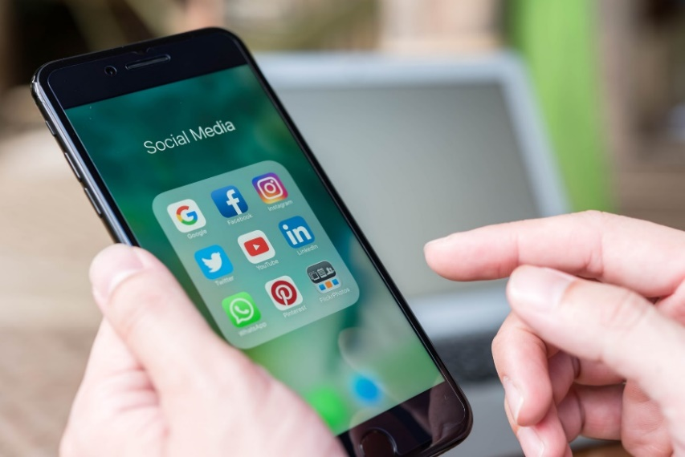
Mobile device categories
Types / Categories:
Social Phone:
A social phone is a smartphone that is focused on social networking as its primary function.
Features of social phones that were being developed in 2009 included apps that focused more on social network interactions.
For example, the Motorola, Motoblur has a widget for its home-screen that monitor three social networking sites: Facebook, Twitter, and MySpace.

Slide 10
Mobile Operating System
A mobile operating system (OS) is software that allows smartphones, tablet PCs (personal computers) and other devices to run applications and programs.
A mobile OS typically starts up when a device powers on, presenting a screen with icons or tiles that present information and provide application access.
Mobile operating systems also manage cellular and wireless network connectivity, as well as phone access.
A mobile operating system is an operating system that helps to run other application software on mobile devices.
It is the same kind of software as the famous computer operating systems like Linux and Windows, but now they are light and simple to some extent.

Slide 11
Types of Mobile Operating System
Android OS: The Android operating system is the most popular operating system today. It is a mobile OS based on the Linux Kernel and open-source software. The android operating system was developed by Google. The first Android device was launched in 2008.
iPhone OS / iOS: The iOS was developed by the Apple inc for the use on its device. The iOS operating system is the most popular operating system today. It is a very secure operating system. The iOS operating system is not available for any other mobiles.
Windows Mobile OS: The window mobile OS is a mobile operating system that was developed by Microsoft. It was designed for the pocket PCs and smart mobiles.
BlackBerry OS: The BlackBerry operating system is a mobile operating system developed by Research In Motion (RIM). This operating system was designed specifically for BlackBerry handheld devices.
Symbian OS: Symbian operating system is a mobile operating system that provides a high-level of integration with communication. The Symbian operating system is based on the java language. It combines middleware of wireless communications and personal information management (PIM) functionality.

Slide 12
Benefits of Mobile Apps
Mobile apps offer better personalization:
Offers tailored communication to users based on their interests, location, usage behavior, and more.
Ease of Sending Notifications:
These notifications are of two types: push and in-app notifications. Both are exciting alternatives for
communicating with app users in a far less intrusive manner.
Making use of mobile device features
Mobile apps have the advantage of utilizing features of a mobile device like camera, contact list, GPS, phone calls, accelerometer, compass, etc.
Ability to work offline
It is probably the most fundamental difference between a mobile website and an app.
Although apps too might require internet connectivity to perform most of their tasks, they can still offer basic content and functionality to users in offline mod

Slide 13
Benefits of Mobile Apps
Freedom in designing
A mobile app can be designed with a lot of elaborate functions, based on advanced gestures like ‘tap,’ ‘swipe,’ ‘drag,’ ‘pinch,’ ‘hold,’ and more.
Apps can work faster than websites
A well-designed mobile app can perform actions much quicker than a mobile website.
New branding experience
Since a mobile app is distinct from a company’s website, it has the liberty of offering a new brand experience to users. It means that the company can experiment with new branding styles for the app, which can be different from the regular brand style of the company’s website

Slide 14
Requirement Gathering for Mobile Applications
To capture the requirements:
Step 1. Analyze the Problem: Describe the problem in detail.
Step 2. Understand User Needs: Clearly state the needs of the clients.
Step 3. Define the System: Describe the systems and its parts in detail.
Step 4. Manage the Scope: Set up boundaries for the system
Step 5. Refine the System Definition: Filter the system for relevant features & data.

Slide 15
Requirement Gathering for Mobile Applications
Requirements gathering techniques:
Brainstorming: Brainstorming is used in requirement gathering to get as many ideas as possible from group of people.
Document Analysis: Reviewing the documentation of an existing system can help when creating process document, as well as driving gap analysis for scoping of migration projects.
Focus Group: A focus group is a gathering of people who are representative of the users or customers of a product to get feedback.
Interface analysis: Interfaces for a software product can be human or machine. Integration with external systems and devices is just another interface.
Interview: Interviews of stakeholders and users are critical to creating the great software
Observation: By observing users, an analyst can identify a process flow, steps, pain points and opportunities for improvement.
Prototyping: In this approach, you gather preliminary requirements that you use to build an initial version of the solution - a prototype.
Survey/Questionnaire: The survey can force users to select from choices, rate something etc

Slide 16
Publishing & Delivery of Mobile Applications
Steps:
Regression Testing: Before you publish your application, you need to make sure that its meeting the basic quality expectations for all Android apps, on all of the devices that you are targeting.
Application Rating: When you will publish your application at Google Play, you will have to specify a content rating for your app, which informs Google Play users of its maturity level.
Targeted Regions: Google Play lets you control what countries and territories where your application will be sold.
Application Size: Currently, the maximum size for an APK published on Google Play is 50 MB. If your app exceeds that size, or if you want to offer a secondary download, you can use APK Expansion Files
Screen Compatibility: It is important to make sure that your app is designed to run properly on the Android platform versions and device screen sizes that you want to target.
Application Pricing: Deciding whether you app will be free or paid.

Slide 17
Publishing & Delivery of Mobile Applications
Steps:
Promotional Content: It is a good marketing practice to supply a variety of high-quality graphic assets to showcase your app or brand.
Finalize Application Detail: Google Play gives you a variety of ways to promote your app and engage with users on your product details page, from colourful graphics, screen shots, and videos to localized descriptions, release details, and links to your other apps. So you can decorate your application page and provide as much as clear crisp detail you can provide.

Slide 18
Introduction to Development Technologies
There are Five major development approaches when building mobile applications
Native Mobile Applications
Cross-Platform Native Mobile Applications
Hybrid Mobile Applications
Progressive Web Applications
Web Based Applications
Native mobile applications:
Native apps are installed onto the device itself and are developed especially for a particular mobile operating system. These apps are available on app stores such as Apple App Store, Google Play Store, etc.Native apps work in specific mobile operating systems such as Apple iOS or Android OS. If an app made for Android OS then it will not work on Apple iOS or Windows OS.
Pros:
Best runtime performance
Direct access to device APIs
Cons:
Higher costs when building and maintaining your app
Multiple code-bases for each platform

Slide 19
Cross Platform applications:
Cross-platform native mobile applications can be written in variety of different programming languages and
frameworks, but they are compiled into a native application running directly on the operating system of the
device. .
Pros:
Single code base for multiple platforms
Easy to build and maintain your app
Cons:
Dependents on bridges and libraries for native device features
Performance limitations due to bridging
Hybrid mobile applications:
Built with standard web technologies - such as JavaScript, CSS, and HTML5 - and they are bundled as app installation packages. It can run both online and offline, if the hybrid software does not depend on data from the database then it can be use offline.It runs across various platform but need to deploy the app’s wrapper.
Pros:
Shared code base between web and mobile apps
Using web development skillset for building mobile apps
Cons:
Lower performance compared to native apps

Slide 20
Progressive web Applications:
Offer an alternative approach to traditional mobile app development by skipping app store delivery and app installations. Combination of native and web.
PWAs are web applications that utilize a set of browser capabilities - such as working offline, running a background process, and adding a link to the device home screen - to provide an 'app like' user experience.
Pros
Same app is available both for web and mobile
No installation required, accessible through a URL
Cons
Limited support for native device features
App capabilities depend on the browser in use
Web Apps:
It can be accessed through the mobile device’s Web browser, Web Apps are based on internet-enabled applications. In order to access we don’t need to download and install the app onto a mobile device.
Pros
Faster to build then native
Updates automatically.
Cons
Slow then mobile apps
Does not work without internet

Slide 21
Android & Versions
Android is a software package and linux based operating system for mobile devices such as tablet computers and smartphones.
It is developed by a startup of the same name Android Inc.
Later was purchased by Google.
Android is an open source
Java language is mainly used to write the android code even though other languages can be used.
The goal of android project is to create a successful real-world product that improves the mobile experience for end users.
Android offers a unified approach to application development for mobile devices which means developers need only develop for Android, and their applications should be able to run on different devices powered by Android.

Slide 22
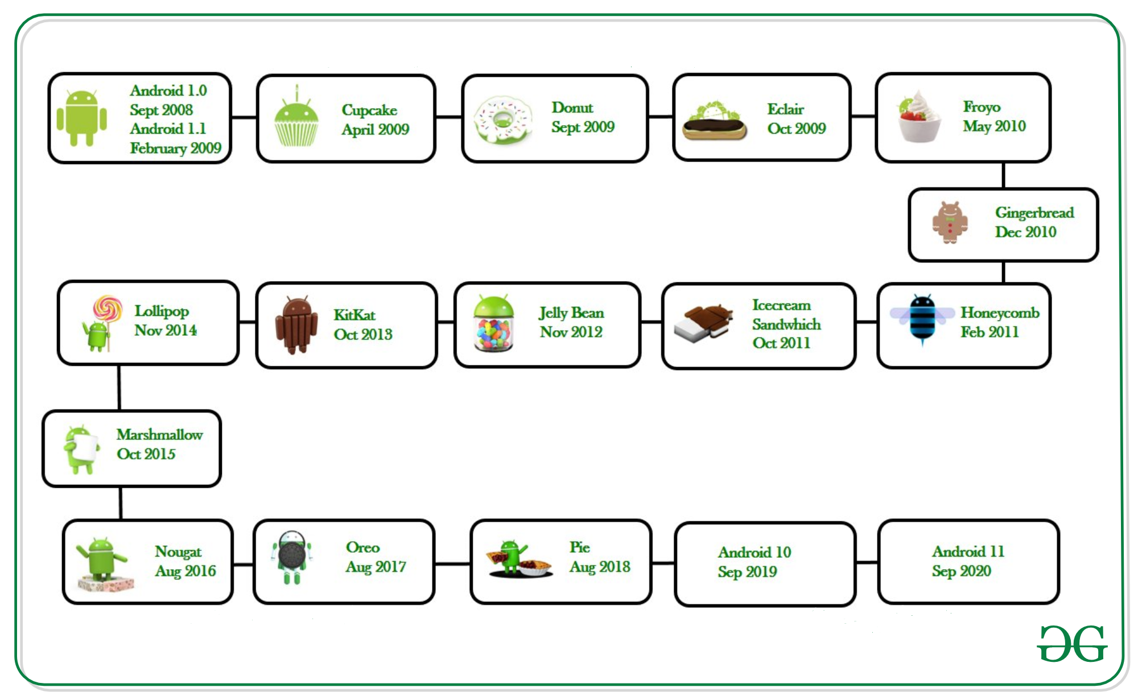

Slide 23
4.4 KitKat (2013)
Google partnered with an actual food company to create the KitKat OS. As for the software itself, it added emojis to the Google Keyboard, had a smaller memory footprint to support lower-end phones and let you print on the go with Google Cloud Print.
6.0 Marshmallow (2015)
Marshmallow introduced Doze Mode to save on battery life. It also added built-in support for a fingerprint reader, USB Type-C and 4K mode for apps.
7.0 Nougat (2016)
With Nougat, you could finally clear all your apps in Overview with a single tap. It let you adjust the skin tone of your emojis and tap through more Quick Setting options. It also supported Google's VR endeavor, Daydream.
8.0 Oreo (2017)
Timed to launch right alongside the 2017 US solar eclipse, Android Oreo served up picture-in-picture apps for even more multitasking. There was also a better copy-and-paste experience, improved security and better battery management.
9.0 Pie (2018)
Android Pie focused on behind-the-scenes improvements that made Android phones work faster and save battery life. That included AI tools that suggested apps and shortcuts you might want to use, and it loaded "slices" of an online page that gave precise information, without the need to download an app search through a webpage.
10.0 Q (2019)
Android Q, which hasn't been named or rolled out in full yet, introduces the beloved Dark Theme, a new pop-up notifications style called Bubbles and live captioning on videos that are being played for more accessibility.

Slide 24
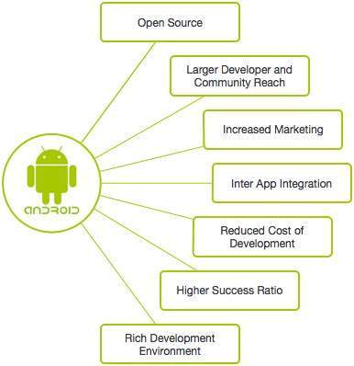
Android Features

Slide 25
Beautiful UI
Android OS basic screen provides a beautiful and intuitive user interface.
Storage
SQLite, a lightweight relational database, is used for data storage purposes.
Media support
H.263, H.264, MPEG-4 SP, AMR, AMR-WB, AAC, HE-AAC, AAC 5.1, MP3, MIDI, Ogg Vorbis, WAV, JPEG, PNG, GIF, and BMP.
Messaging
SMS and MMS
Multi-touch
Android has native support for multi-touch which was initially made available in handsets such as the HTC Hero.
Multi-tasking
User can jump from one task to another and same time various application can run simultaneously.

Slide 26
Resizable widgets
Widgets are resizable, so users can expand them to show more content or shrink them to save space.
Multi-Language
Supports single direction and bi-directional text.
GCM
Google Cloud Messaging (GCM) is a service that lets developers send short message data to their users on Android devices, without needing a proprietary sync solution.
Wi-Fi Direct
A technology that lets apps discover and pair directly, over a high-bandwidth peer-to-peer connection.

Slide 27
Android Architecture
Android architecture or Android software stack is categorized into five parts:
linux kernel
native libraries (middleware),
Android Runtime
Application Framework
Applications

Slide 28
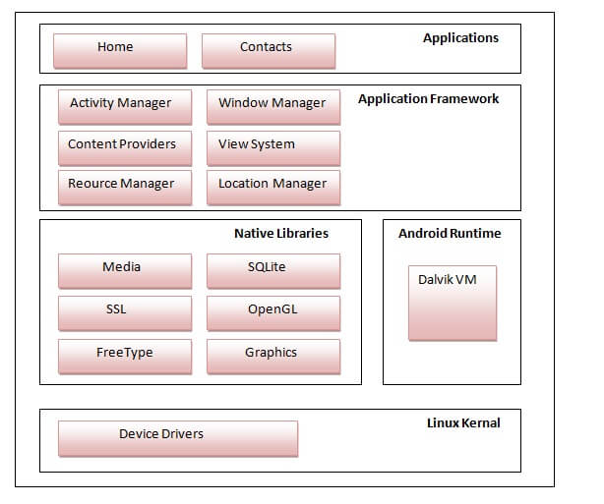

Slide 29
Linux kernel
It is the heart of android architecture that exists at the root of android architecture.
Linux kernel is responsible for device drivers, power management, memory management, device management and resource access.
This provides a level of abstraction between the device hardware and it contains all the essential hardware drivers like camera, keypad, display etc.
Native Libraries
On the top of linux kernel, their are Native libraries such as WebKit, OpenGL, FreeType, SQLite, Media, C runtime library (libc) etc.
The WebKit library is responsible for browser support, SQLite is for database, FreeType for font support, Media for playing and recording audio and video formats.
Android Runtime
In android runtime, there are core libraries and DVM (Dalvik Virtual Machine) which is responsible to run android application.
It is like JVM but it is optimized for mobile devices.
It consumes less memory and provides fast performance. The Dalvik VM makes use of Linux core features like memory management and multi-threading, which is intrinsic in the Java language

Slide 30
Application Framework
The Application Framework layer provides many higher-level services to applications in the form of Java classes. Application developers are allowed to make use of these services in their applications.
The Android framework includes the following key services −
Activity Manager − Controls all aspects of the application lifecycle and activity stack.
Content Providers − Allows applications to publish and share data with other applications.
Resource Manager − Provides access to non-code embedded resources such as strings, color settings and user interface layouts.
Notifications Manager − Allows applications to display alerts and notifications to the user.
View System − An extensible set of views used to create application user interfaces.
Applications
You will find all the Android application at the top layer.
You will write your application to be installed on this layer only. Examples of such applications are Contacts Books, Browser, Games etc.

Slide 31
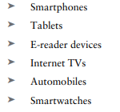
Android Devices in the Market
There are many types of android devices in the market with all shapes and sizes:
A cell phone that has functions like that of a computer
A tablet is a wireless, portable personal computer with a touchscreen interface.
An e-reader, is a mobile electronic device that is designed primarily for the purpose of reading digital docs.
Internet TV (ITV) is generally-available content distributed over the Internet.
A system that allows your car's infotainment screen to display content from your mobile phone
A mobile device with a touchscreen display, designed to be worn on the wrist.

Slide 32
Android Market
The Android Market was an online store offering software applications designed for Android devices. Users gain access to the Android Market through its website or the Market application installed on Android mobile devices.
Android apps are not only available on the Android Market. After registering for an Android Market account, developers may choose to make their apps available on their own websites.
Developers pay a $25 one-time registration fee before they can start uploading applications to the Android Market. They need to open a Google Checkout Merchant account to receive payment. When a developer sells an app on the Android Market, Google gets 30 percent for each copy of the app downloaded.

Slide 33
Obtaining the Required Tools
Before we start developing our android application, we need to obtain/install the following tools:
Android Studio
Android SDK
Creating Android Virtual Devices
The Android Developer Community

Slide 34
Android Studio
Android Studio provides a unified environment where you can build apps for Android phones, tablets, Android Wear, Android TV, and Android Auto.
Features of Android Studio:
Instant App Run
It is an advanced technology in which it cleverly understands the transmutations done in the applications and deliver it instantly without taking time to rebuild the apk and installations make. So, quick that you can see the changes in app immediately.
Visual Layout Editor
Layout editor helps to build the layout quickly by adding different attributes either by hard-code or drag and drop.

Slide 35
Features of Android Studio:
Fast Emulator
Android has a great feature of Emulator which is exactly like the android phones to test how the application looks like in physical devices.
Intelligence Code Editor
Android Studio provides you with the intelligent and quick code editor. This will help you and guide you with the accurate code.
Addition of New Activity as a Code Template
Yes, Android also has the feature of templates built-in. If you know to build that accordingly that makes your task easier.
Help to Build Up App for All Devices
Android studio builds applications for every screen size, for wear and gear devices etc.
Colour Previews
Android studio helps to see the code XML part in a preview to know that how perfectly we are designing the application according to the need before launching the application.

Slide 36
Android SDK
The Android SDK is a software development kit that includes a comprehensive set of development tools.
These include a debugger, libraries, a handset emulator based on QEMU, documentation, sample code, and tutorials.
The most important piece of software you need to download is, of course, the Android SDK.
The Android SDK contains all of the packages and tools required to develop a functional Android application.
The SDKs are named after the version of Android OS to which they correspond.

Slide 37
Android Virtual Devices
An Android Virtual Device (AVD) is a configuration that defines the characteristics of an Android phone, tablet, Wear OS, Android TV, or Automotive OS device that you want to simulate in the Android Emulator.
An Android Virtual Device (AVD) you can use for testing your Android applications. One important thing to remember about emulators is that they are not perfect.
Each AVD consists of a hardware profile; a mapping to a system image; and emulated storage, such as a secure digital (SD) card.
There are some applications, such as games (which are GPU heavy) or applications that use sensors such as the GPS or accelerometer. These types of applications cannot be simulated with the same speed or consistency within an emulator as they can when running on an actual device.
However, the emulator is good for doing some generalized testing of your applications.
You can create as many AVDs as you want to test your applications with different configurations.

Slide 38
Android Developer Community
It is a place where coders share, stay up-to-date and grow their careers.
The following are some developer communities and websites that you can turn to for help if you run into problems while working with Android:
Stack Overflow (www.stackoverflow.com)—Stack Overflow is a collaboratively edited question-and-answer site for developers.
Google Android Training (http://developer.android.com/training/index.html)— Google has launched the Android Training site, which contains a number of useful classes grouped by topics.
Android Discuss (http://groups.google.com/group/android-discuss)—Android Discuss is a discussion group hosted by Google using the Google Groups service. Here, you will be able to discuss the various aspects of Android programming.

Slide 39
Code Completion
Code completion is an invaluable tool that shows you contextual options for completing the piece of code that you are trying to write.
Android Studio Code Completion should display a list of values that you could use to try to complete the code statement.
Android Studio has three types of code completion
Basic Completion: Displays basic suggestions for variables, types, methods, expressions, and so on.
Smart Completion: Displays relevant options based on the context. Smart completion is aware of the expected type and data flows.
Statement Completion :Completes the current statement for you, adding missing parentheses, brackets, braces, formatting, etc.

Slide 40
Publish your Application
After you have created, and fully debugged, your application, you might want to deploy it to the Google Store for others .
To publish your finished application on the Google Play Store, you must generate a signed APK(the Android application package).
The APK is the compiled, executable version of your application.
Signing it is much like signing your name to a document.
The signature identifies the app’s developer to Google and the users who install your application.

Slide 41
Android Application Components
The 4 main components that can be used within an Android application:
Activities
They dictate the UI and handle the user interaction to the smart phone screen.
Services
They handle background processing associated with an application.
Broadcast Receivers
They handle communication between Android OS and applications.
Content Providers
They handle data and database management issues.

Slide 42
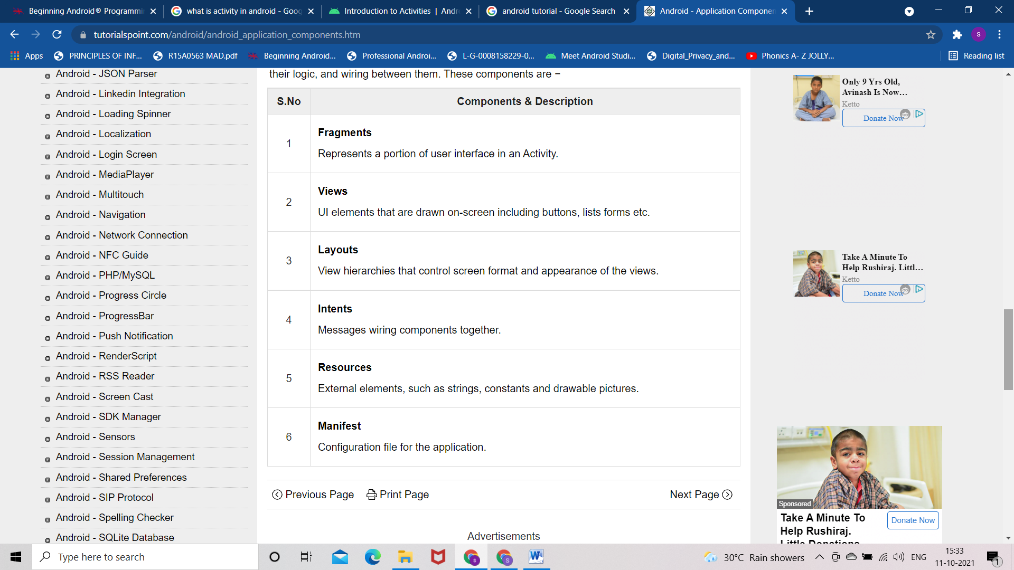
Additional Components:

